Slide 1
19CSE305: MACHINE LEARNING

Slide 2
KNN Algorithm
K-Nearest Neighbor Algorithm

Slide 3
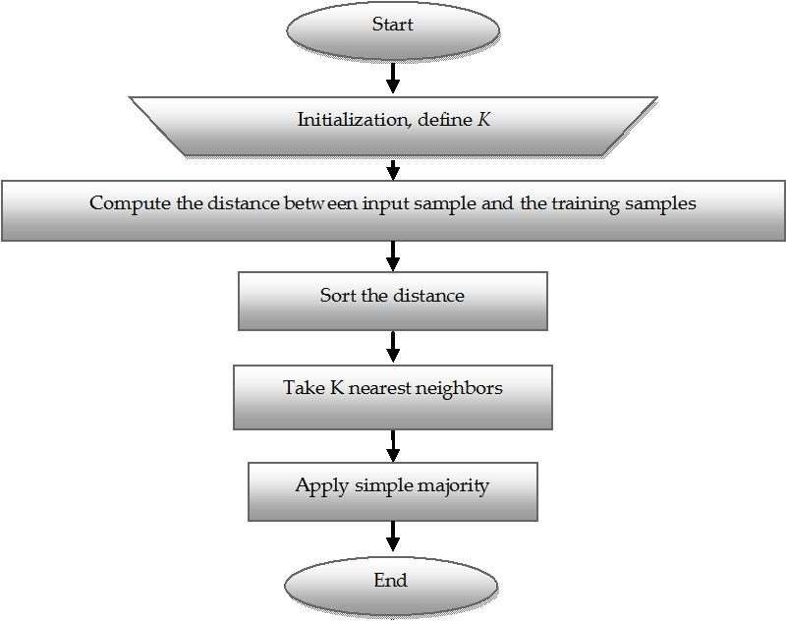
KNN Classifier Algorithm

Slide 4
Example 1
We have data from the questionnaires survey and objective testing with two attributes (acid durability and strength) to classify whether a special paper tissue is good or not. Here are four training samples :
X1 = Acid Durability (seconds) | X2 = Strength (kg/square meter) | Y = Classification
7 | 7 | Bad
7 | 4 | Bad
3 | 4 | Good
1 | 4 | Good
Now the factory produces a new paper tissue that passes the laboratory test with X1 = 3 and X2 = 7. Guess the classification of this new tissue.

Slide 5
Step 1 : Initialize and Define k.
Lets say, k = 3
(Always choose k as an odd number if the number of attributes is even to avoid a tie in the class prediction)
Step 2 : Compute the distance between input sample and
training sample
Co-ordinate of the input sample is (3,7).
Instead of calculating the Euclidean distance, we
calculate the Squared Euclidean distance.
X1 = Acid Durability (seconds) | X2 = Strength (kg/square meter) | Squared Euclidean distance
7 | 7 | (7-3)² + (7-7)² = 16
7 | 4 | (7-3)² + (4-7)² = 25
3 | 4 | (3-3)² + (4-7)² = 09
1 | 4 | (1-3)² + (4-7)² = 13

Slide 6
Step 3 : Sort the distance and determine the nearest neighbours based of the K^{th} minimum distance :
X1 = Acid Durability (seconds) | X2 = Strength (kg/square meter) | Squared Euclidean distance | Rank minimum distance | Is it included in 3-Nearest Neighbour?
7 | 7 | 16 | 3 | Yes
7 | 4 | 25 | 4 | No
3 | 4 | 09 | 1 | Yes
1 | 4 | 13 | 2 | Yes

Slide 7
Step 4 : Take 3-Nearest Neighbours:
Gather the category Y of the nearest neighbours.
X1 = Acid Durability (seconds) | X2 = Strength (kg/square meter) | Squared Euclidean distance | Rank minimum distance | Is it included in 3-Nearest Neighbour? | Y = Category of the nearest neighbour
7 | 7 | 16 | 3 | Yes | Bad
7 | 4 | 25 | 4 | No | -
3 | 4 | 09 | 1 | Yes | Good
1 | 4 | 13 | 2 | Yes | Good

Slide 8
Step 5 : Apply simple majority
Use simple majority of the category of the nearest
neighbours as the prediction value of the query instance.
We have 2 “good” and 1 “bad”. Thus we conclude that the new paper tissue that passes the laboratory test with X1 = 3 and X2 = 7 is included in the “good” category.

Slide 9
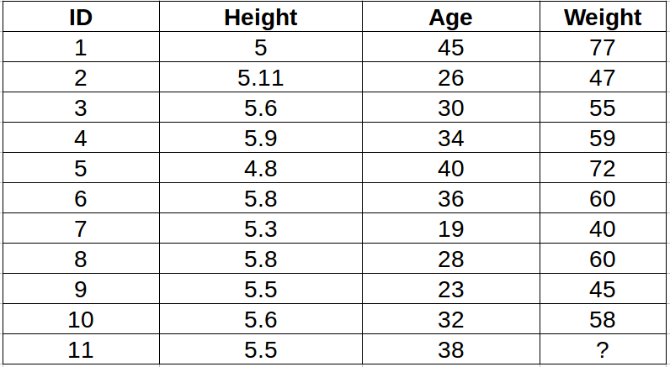
Example 2
Predict the weight of ID11 for K=3 and K=5

Slide 10
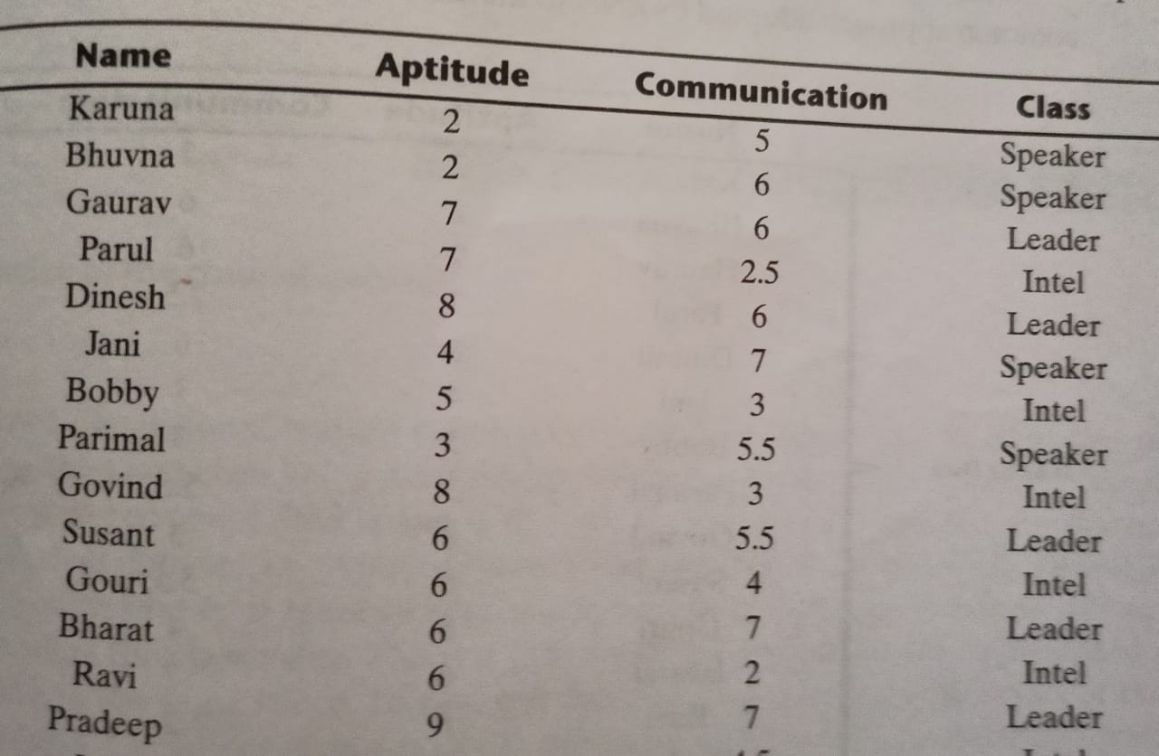
Example 3
Find the label for the test data:
Josh 5 4.5
For K=1,2,3

Slide 11
THANK YOU

